Slide 1
TradWives - a trend for me?

Slide 2

Your life's dream in a hashtag!
What is your personal life's dream? Think about your dream and add it as a hashtag to this word cloud.
Example: #Traveltheworld

Slide 3
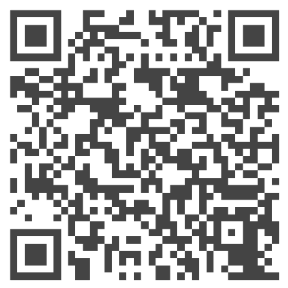
What does it mean to be a #TradWife?
Have you heard of the #TradWife trend? Watch the video and finish the sentence starters given on the worksheet.
‘Submitting to my husband like it's 1959': Why I became a TradWife ¦ BBC Stories - YouTube

Slide 4
Collection of Arguments
You have heard some arguments that may be in favour of becoming a tradwife. Which other arguments can you think of?
You may use the sentence starters as support:
There is no doubt that …
As far as I am concerned ...
In my opinion, ...
From my perspective, ..
It is a fact that ...
One may say that ..
One may say that...
In my experience …
A major concern is …
It can be argued that …
Some people feel …

Slide 5
Hot Seat!
Imagine you are participating in a talk show:
      Partner A: Play the role of a #TradWife or #TradHusband.
      Partner B: Prepare critical questions on the lifestyle.
How will you convince the audience that you have made the right choice?
Which (critical) questions could you ask? Refer back to the arguments you have written down before and make notes.
Then, work with the person behind / in front of you that has prepared the same role. Compare your notes and add ideas that you like.

Slide 6
☼ A day in my life
Imagine you are a #TradWife or #TradHusband. What would a typical day look like for you? You can either send a voice message to your friend or write a diary entry answering the following questions:
  What did you do today?
  How do feel about your choice of becoming a #TradWife or #TradHusband?
  Do you regret it? Why (not)?
  How do you imagine your life in three years from now?

