Slide 1
TradWives - a threat to feminism?

Slide 2

What is feminism to you?
Come up with your dictionary entry for the word 'feminism'.

Slide 3



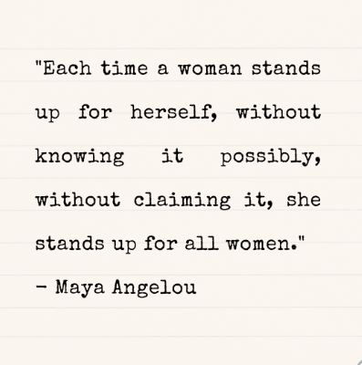
Quotes about Feminism
I have brought a variety of famous quotes about feminism. With your partner, pick one that you think best represents your view of feminism and justify your choice.

Slide 4
Partner Puzzle: Tradewives
What are societal implications of being a "Tradwife"?
Partner A will watch the BBC report "Why I became a Tradwife".
Partner B will watch an excerpt from the British talk show "Loose Women" on the question whether Tradwives are damaging to other women.
While watching,
write down a definition of the term "Tradwife"
in a table, note central arguments in favour and against becoming a "Tradwife".
Afterwards, compare your results with a partner and add to them if necessary.

Slide 5


Partner A: BBC Stories - Why I became a TradWife | Partner B: Loose Woman - Are ‘Trad-Wives’ Damaging To Other Women In Today’s Society?

Slide 6

The Tradwife movement… a threat to feminism?
Is the #tradwife movement a threat to feminism?
You will receive a snippet of paper with a (controversial) question or statement on it. Walk around, find somebody to talk to and discuss your and their snippets.
After having finished your discussion, swap the snippets and find a new partner.
Zur digitalen Version

Slide 7

Writing an Op-Ed
An Op-Ed (short for "opposite the editorial page") is an opinion piece written by readers of a newspaper of journal. This text usually represents a very strong and focused opinion of a writer.
The New York Times has asked you to write an Op-Ed on the #tradwife movement.
Pick your role: you are either a feminist or a tradwife / tradhusband.
Write an Op-Ed with the title → 'The tradwife movement is a threat / an enrichment to feminism. Here's why.'

Slide 8



Writing an Op-Ed – Additional Resources
Op-ed Writing: Tips and Tricks | Sometimes I long for the life of a tradwife. Then I remember it’s a reactionary fantasy | Writing Effective Op-Eds

Slide 9

Editor´s Conference
The New York Times has received your articles and now the editors want to decide which article to publish.
Using the criteria provided, evaluate different articles and give feedback on them!

